Slide 1
ORIGAMI INSTRUCTIONS
Online origami instructions
https://www.origamiway.com/origami-step-by-step.shtml

Slide 2
ORIGAMI BUTTERFLY.
Listen carefully and follow the given instructions.
Step 1: Start with a square piece of origami paper.
Step 2: Fold the paper in half by folding the upper left corner to the lower right corner.
Step 3: Unfold.
Step 4: Fold in half again by folding the upper right corner to the lower left.
Step 5: Unfold.
Step 6: Fold in half again by folding the top half back.
Step 7: Unfold.
Step 8: With your finger, push down on the middle so that it pops in.
Step 9: Bring the left and right creases together to form a triangle.
Step 10: Fold the left corner of the top layer to the top corner of the triangle.
Step 11: Fold the right corner to the top corner.
Step 12: Turn over

Slide 3

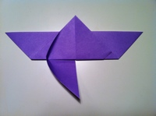
ORIGAMI BUTTERFLY.
Step 13: Fold the bottom part of the triangle up with a portion of the top
corner showing, like in the picture.
Step 14: Turn over.
Step 15: Pull down the left flap of the triangle and the side will be forced
to bend in. Fold and flatten the side down.
Step 16: Like before, pull down the right flap and fold in the side.
Step 17: Turn over.
Step 18: Fold down the top triangle.

Slide 4

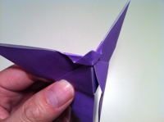

Step 19: Fold a good portion of the triangle back up, but leave some parts folded down.
Step 20: Mountain fold in half. In other words, fold the left side under the right side.
Step 21: Diagonally fold the wing as shown.

Slide 5

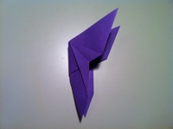

Step 22: Turn over.
Step 23: Fold the other wing the same way.
Step 24: Open the wings and you have a beautiful butterfly.

